Slide 1
Mark 12:13-17

Slide 2
¹³ And they sent to him some of the Pharisees and some of the Herodians, to trap him in his talk. ¹⁴ And they came and said to him, “Teacher, we know that you are true and do not care about anyone’s opinion. For you are not swayed by appearances, but truly teach the way of God. Is it lawful to pay taxes to Caesar, or not? Should we pay them, or should we not?” ¹⁵ But, knowing their hypocrisy, he said to them, “Why put me to the test? Bring me a denarius and let me look at it.” ¹⁶ And they brought one. And he said to them, “Whose likeness and inscription is this?” They said to him, “Caesar’s.” ¹⁷ Jesus said to them, “Render to Caesar the things that are Caesar’s, and to God the things that are God’s.” And they marvelled at him.

Slide 3
Bush Disciples
E O F Y
Special

Slide 4
Bush Disciples
E O F Y
Special
The purpose of Taxation
To fund the Government to provide
National security
Law and Order
Education
Transport infrastructure
Healthcare
Welfare

Slide 5
Taxation provides funding for Government
to provide Defence, Law & Order, and Services
Taxes extra unpopular in Israel – paid to their oppressors (Romans)
Pharisees
Herodians
Religious Lay purity movement
All about religious purity
Against Rome
Political supporters of King Herod
Hedonism – indulgence to excess
Rome was an ally
“Teacher, we know that you are true and do not care about anyone’s opinion. For you are not swayed by appearances, but truly teach the way of God. Is it lawful to pay taxes to Caesar, or not? Should we pay them, or should we not?” ¹⁵ But, knowing their hypocrisy, he said to them, “Why put me to the test? Bring me a denarius and let me look at it.”

Slide 6
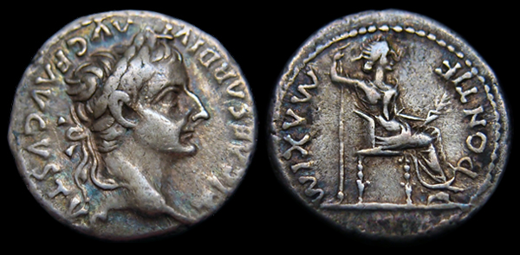
“Whose likeness and inscription is this?” They said to him, “Caesar’s.” ¹⁷ Jesus said to them, “Render to Caesar the things that are Caesar’s, and to God the things that are God’s.” And they marvelled at him.

Slide 7
Hypocrisy of Pharisees & Herodians
Conspiring against Jesus
Marvelled at Jesus’ Answer
Their questions was in terms of “giving” (like a gift) to Caesar
Jesus’ answer was in terms of “giving back” what is rightfully owed.
The State is an institution ordained by God to govern.
It is Godly to pay taxes

Slide 8
^{Romans 13:1} Let every person be subject to the governing authorities. For there is no authority except from God, and those that exist have been instituted by God. ² Therefore whoever resists the authorities resists what God has appointed, and those who resist will incur judgment. ³ For rulers are not a terror to good conduct, but to bad. Would you have no fear of the one who is in authority? Then do what is good, and you will receive his approval, ⁴ for he is God’s servant for your good. But if you do wrong, be afraid, for he does not bear the sword in vain.

Slide 9
For he is the servant of God, an avenger who carries out God’s wrath on the wrongdoer. ⁵ Therefore one must be in subjection, not only to avoid God’s wrath but also for the sake of conscience. ⁶ For because of this you also pay taxes, for the authorities are ministers of God, attending to this very thing. ⁷ Pay to all what is owed to them: taxes to whom taxes are owed, revenue to whom revenue is owed, respect to whom respect is owed, honour to whom honour is owed.

Slide 10
^{1 Peter 2:13} Be subject for the Lord’s sake to every human institution, whether it be to the emperor as supreme, ¹⁴ or to governors as sent by him to punish those who do evil and to praise those who do good. ¹⁵ For this is the will of God, that by doing good you should put to silence the ignorance of foolish people. ¹⁶ Live as people who are free, not using your freedom as a cover-up for evil, but living as servants of God. ¹⁷ Honour everyone. Love the brotherhood. Fear God. Honour the emperor.

Slide 11
Hypocrisy of Pharisees & Herodians
Conspiring against Jesus
Marvelled at Jesus’ Answer
Their questions was in terms of “giving” (like a gift) to Caesar
Jesus’ answer was in terms of “giving back” what is rightfully owed.
The State is an institution ordained by God to govern.
It is Godly to pay taxes – supporting a ministry of God
Having an ungodly government is no excuse to not pay tax
Give back to God, the things that belong to God
God’s image is on us (created in the image of God)
Do not give to the state, what rightfully belongs to God
Give to God, all that we are
Love the Lord with all our heart; soul; mind; strength
Our worship rightfully belongs to God
Let’s not rob God of what is rightfully His. He owns us twice over (created & redeemed)
Our witness rightfully belongs to God
Our service rightfully belongs to God

